Slide 1


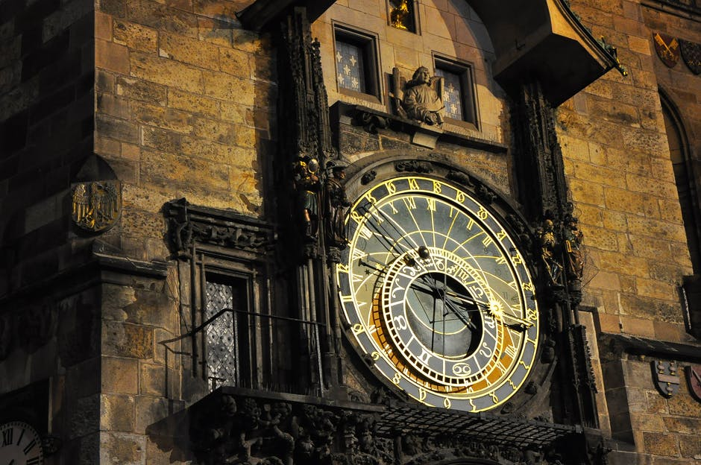
Python is an interpreted high-level programming language for general-purpose programming
Guido van Rossum
Named after famous British comedy show
Monty Python's Flying Circus.

Slide 2
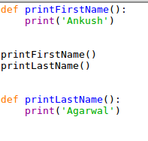

Interpreter Language
What will it print?
An interpreted language is a type of programming language which execute instructions line by line without previously compiling a program into machine-language instructions.
We can run python interactively, we can type a line of Python (a sentence) and Python processes it immediately and is ready for us to type another line of Python.
The first interpreted high-level language was Lisp.
Lisp was first implemented in 1958 by Steve Russellon an IBM 704 computer
The Python interpreter is written in a high-level language called “C”

Slide 3
High Level Language
A high-level language (HLL) is a programming language that enables a programmer to write programs that are more or less independent of a particular type of computer.
In 1954, language FORTRAN was invented at IBM by a team led by John Backus

Slide 4
General Purpose Programming
Need a script to automate part of your workload ? Python is there for you
Need to setup web page and/or web service ? Python is there for you
Want to take a better look at your data and make analysis on top of it? Python is there for you
In computer software, a general-purpose programming language is a programming language designed to be used for writing software in the widest variety of application domains
HTML - markup

Slide 5
Building Blocks of Programs
Read Input
Process Input
Output
Input
Files-txt,
csv,
User Input
Variable
Statement
Datatype -List,
Set,Tuple,
Dict,String
Functions
Conditions
Iteration
Database
Visualization

